Slide 1
Flight price prediction
Submitted by
Ankita Srivastava

Slide 2
Project Overview
Problem Defination
we will be analyzing the flight fare prediction using Machine Learning dataset using essential exploratory data analysis techniques then will draw some predictions about the price of the flight based on some features such as what type of airline it is, what is the arrival time, what is the departure time, what is the duration of the flight, source, destination and more.

Slide 3
Data Collection
For accurate and real time analysis data is prepared from scratch.
Data is scraped from “ makemytrip.com”
Makemytrip website - https://makemytrip.com/
Store it as a CSV file
Makemytrip website
Extract the fetures
Downloading the URL f each airlines
Scraping data using Beautiful soup

Slide 4
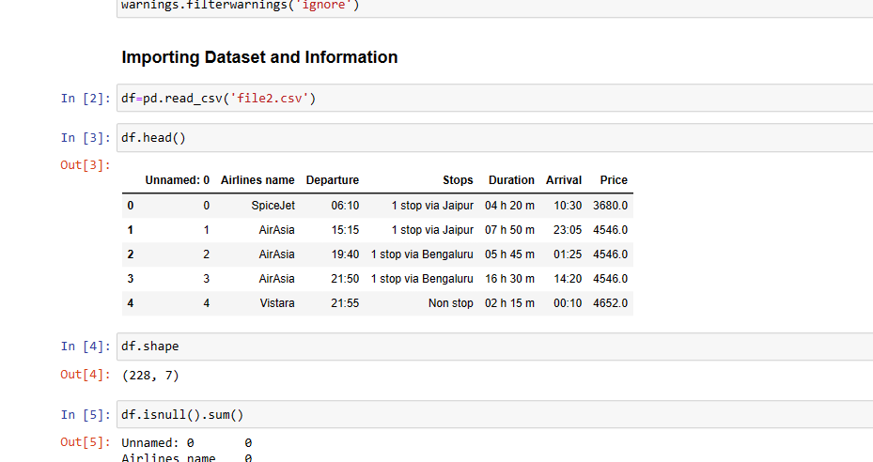
Data set
Obtain 237 data after scrping, here 237 rowes and 7 column

Slide 5
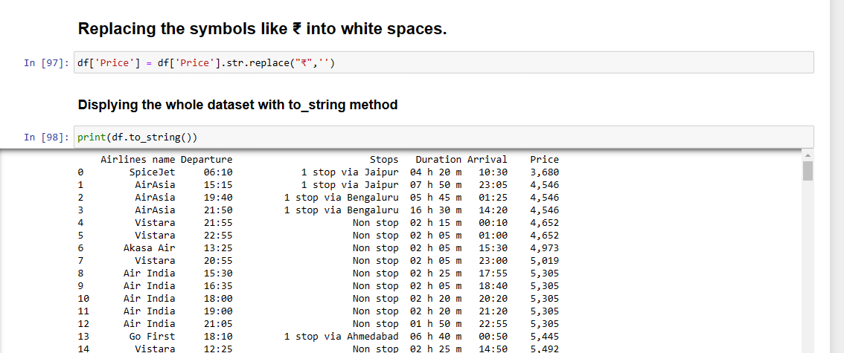
Data Cleaning
Inside column , deatail’s like currency symbol words are removed for each Row.

Slide 6
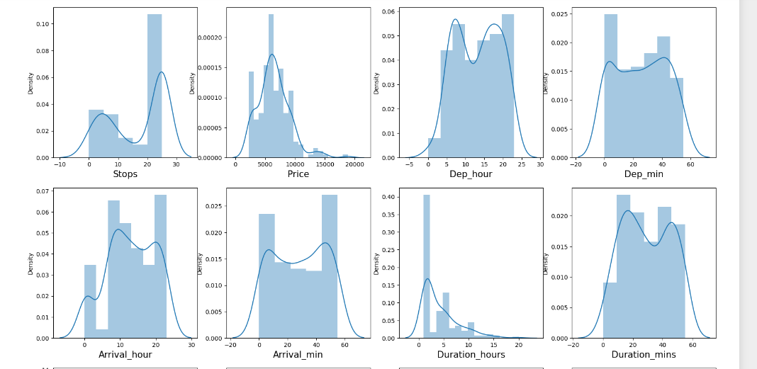
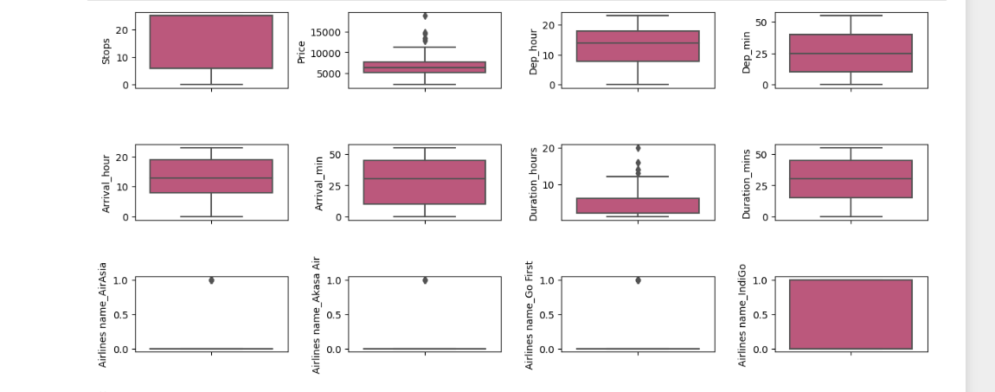
Data Visualization

Slide 7
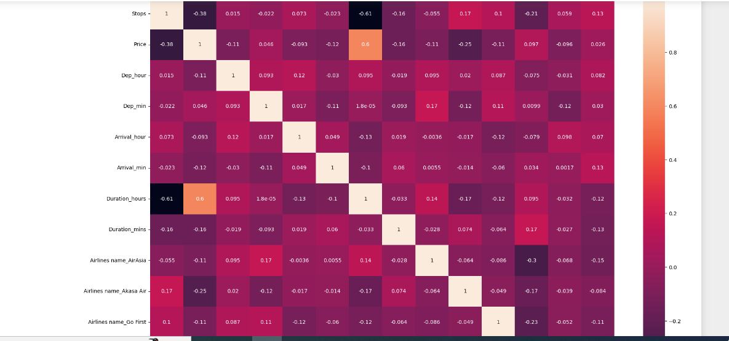
Heat map

Slide 8
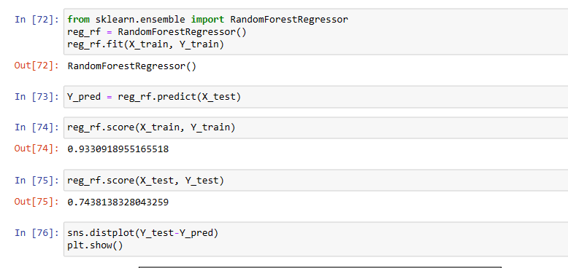
Creating And evaluating the model

Slide 9
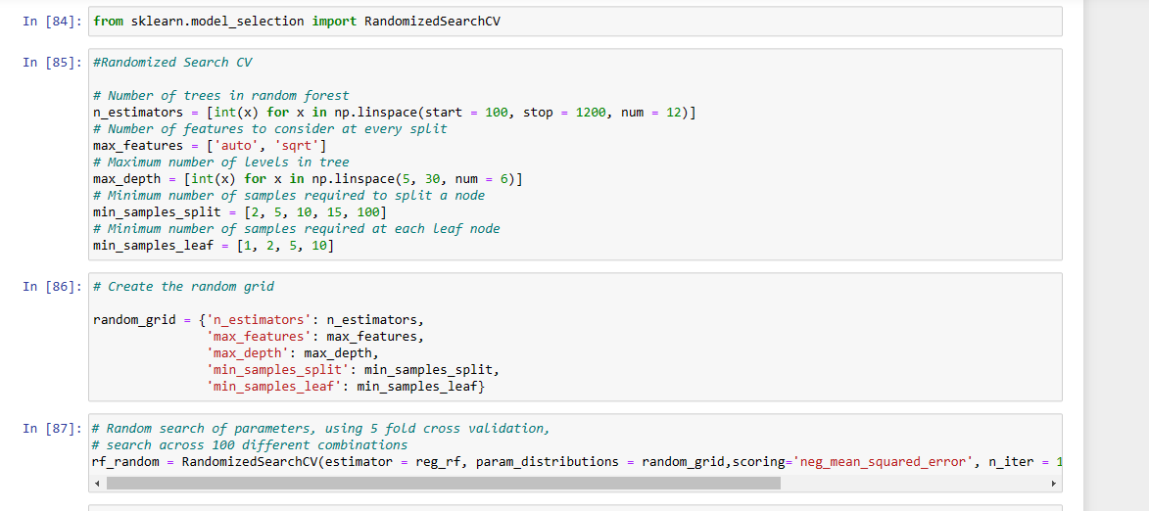
Hyperparameter tunning

Slide 10
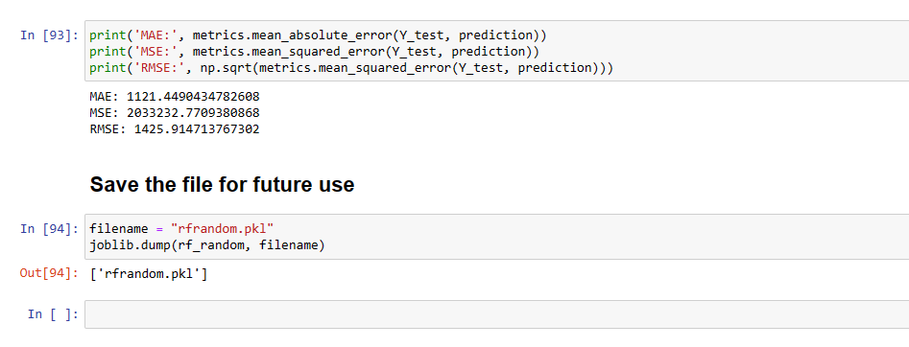
Save the model
When I find the best model for prediction , it have to save for futures use only.

Slide 11
The end

